Slide 1
Face Recognition and Human Tracking Robot
Real-time Face Detection, Embedding Extraction, and Tracking with OpenFace & Dlib
Amar Sunadholi
November 4, 2025

Slide 2

System Overview
Real-time face detection and recognition.
Human tracking through webcam and video feed.
Face alignment and embedding extraction using OpenFace.
Human tracking with bounding box and recognized identities.
Real-time updates and visual feedback for continuous recognition.

Slide 3

Required Libraries & Modules
OpenCV: For capturing video frames and performing face detection.
Dlib: For face landmark detection and face alignment.
OpenFace: For extracting face embeddings using deep neural networks.
Scikit-learn: For normalizing the face embeddings.
Torch: For running OpenFace's pre-trained neural network.
NumPy: For numerical operations, including distance calculations.

Slide 4
Installing Required Libraries
- Install dependencies via pip and conda:
OpenCV: pip install opencv-python
Dlib: pip install dlib
OpenFace:
git clone https://github.com/cmusatyalab/openface.git
cd openface
pip install -r requirements.txt
Scikit-learn: pip install scikit-learn
PyTorch: pip install torch torchvision

Slide 5
Face Detection with OpenCV
Code:
facedetect = cv2.CascadeClassifier('data/haarcas cade_frontalface_default.xml’)
if facedetect.empty():
print('Error loading face cascade!')
exit()
Explanation:
Uses Haar Cascade to detect faces in the live video feed.
Can switch to Dlib’s CNN detector for better accuracy.

Slide 6
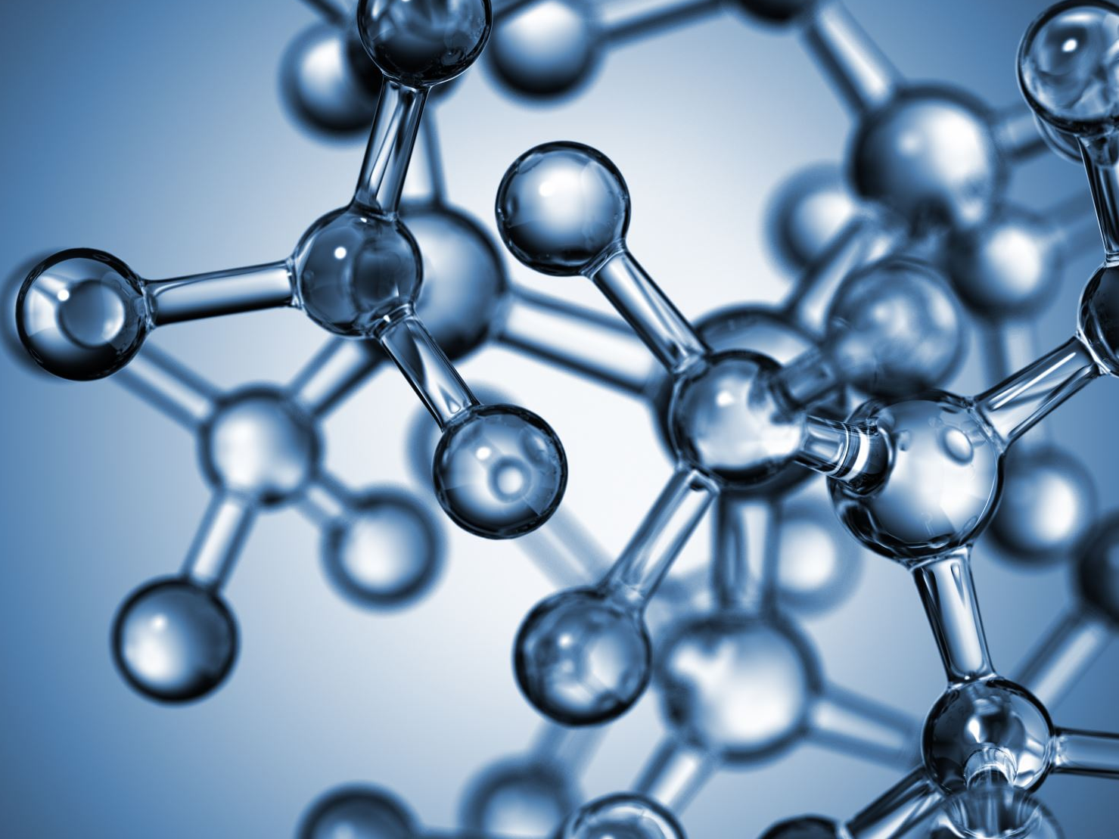
Face Alignment and Embedding Extraction
Code:
Explanation: Dlib aligns faces based on facial landmarks OpenFace neural network extracts a 128-dimensionallandmarks OpenFace neural network extracts a 128-dimensional embedding.
aligner = align_dlib.AlignDlib(PREDICTOR_PATH)aligned_face = aligner.align(96, frame, landmarkIndices=align_dlib.AlignDlib.OUTER_EYES_AND_NOSE) face_embedding=net.forward(aligned_face)

Slide 7

Human Tracking
Code:
tracker = cv2.TrackerKCF_create()
tracker.init(frame, (x, y, w, h))
Explanation:
OpenCV's tracking algorithms (e.g., KCF, TLD) are used to track faces.
Bounding box updates for each detected and tracked face.

Slide 8
Storing and Recognizing Faces
Code:
known_faces = {}
known_faces[identity] = face_embedding
identity = recognize_face(face_embedding, known_faces)
Explanation:
Captures and stores face embeddings in a dictionary.
Recognizes faces by comparing embeddings using Euclidean distance.

Slide 9
Face Recognition Using Euclidean Distance
Code:
def recognize_face(face_embedding, known_faces):
min_dist = float('inf')
identity = None
for name, known_embedding in known_faces.items():
dist = np.linalg.norm(face_embedding - known_embedding)
if dist < min_dist:
min_dist = dist
identity = name
return identity
Explanation:
Compares the current face’s embedding with stored embeddings.
Uses Euclidean distance for matching faces.

Slide 10
Normalization of Embeddings
Code:
from sklearn.preprocessing import Normalizer
normalizer = Normalizer(norm='l2')
normalized_embedding = normalizer.transform(face_embedding.reshape(1, -1))
Explanation:
Normalizing embeddings (L2 norm) ensures consistency for comparison.
Improves the accuracy of face recognition.

Slide 11
Continuous Webcam Feed & Tracking
Code:
video = cv2.VideoCapture(0)
while True:
ret, frame = video.read()
faces = facedetect.detectMultiScale(frame, 1.3, 5)
for (x, y, w, h) in faces:
cv2.rectangle(frame, (x, y), (x+w, y+h), (0, 255, 0), 2)
tracker.update(frame)
cv2.imshow('Frame', frame)
Explanation:
Captures video feed and tracks faces frame-by-frame.
Shows real-time updates of detected faces and their identities

